Slide 1

MAE 224
Lab 2 Velocity and Pressure
2021.2.22

Slide 2
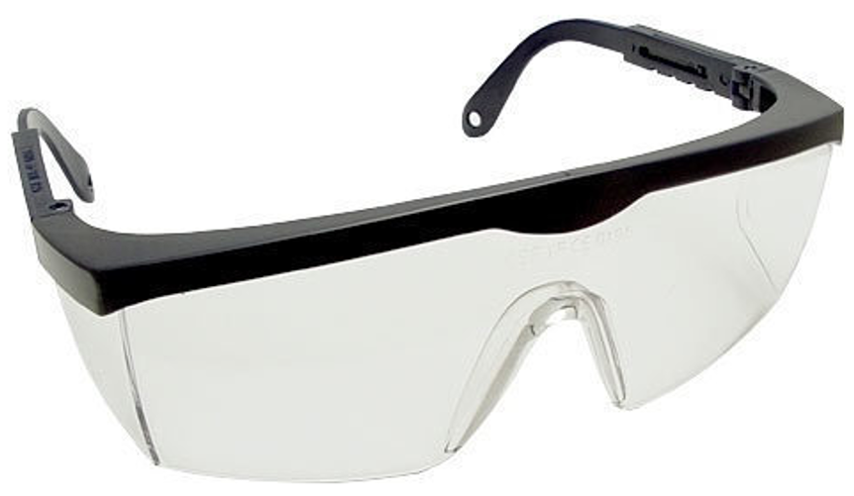
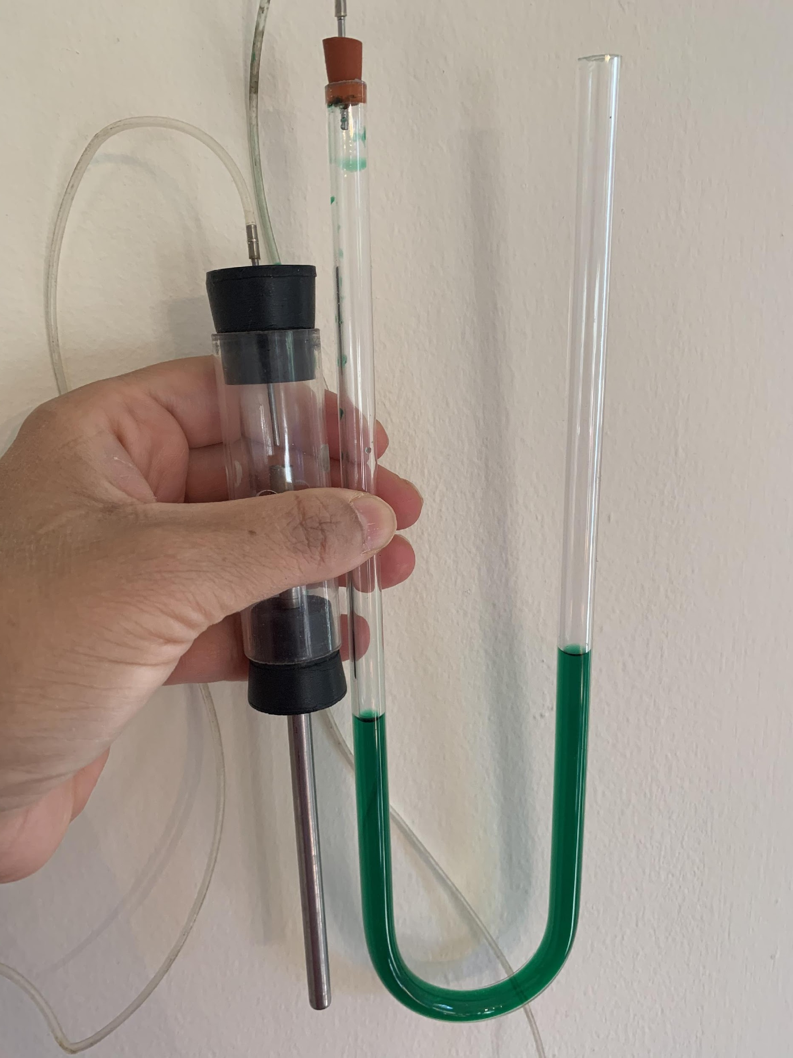
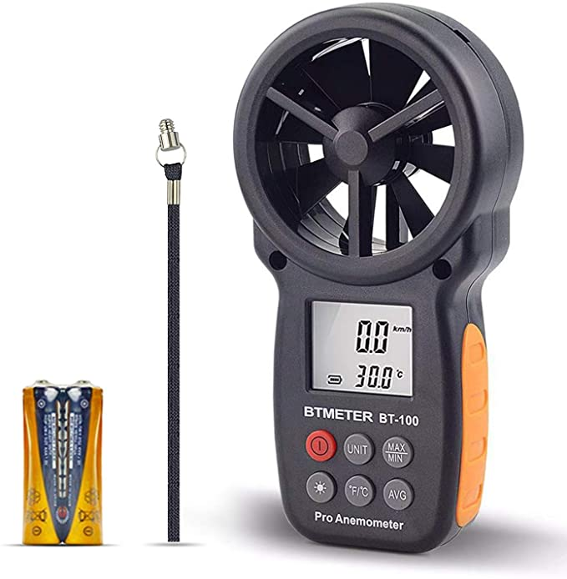
Lab2 Objectives
Understand the principles of pitot tube
Application of Bernoulli’s Equation
Measure air velocity
Other velocity measurements
Lab Kits
Goggle
Pitot Tube Built by Mike Vocaturo
Anemometer

Slide 3
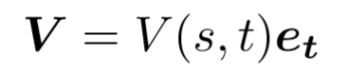
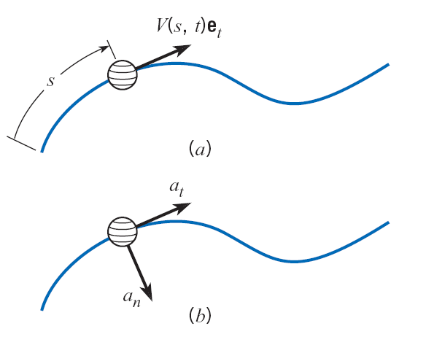
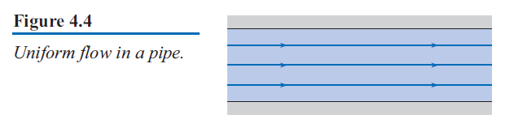
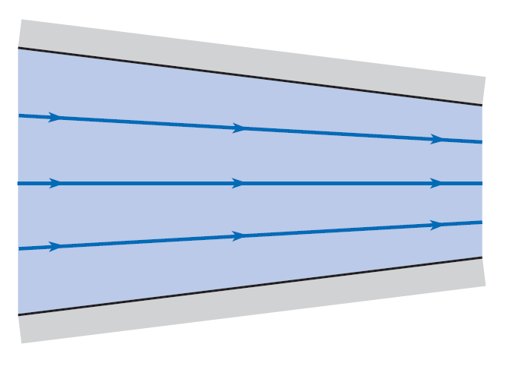
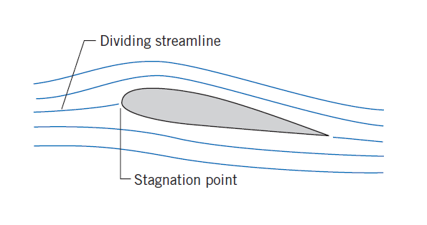
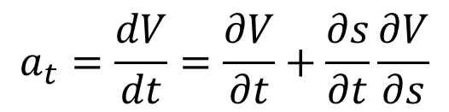
Streamline
A streamline is a curve that is everywhere tangent to the instantaneous local velocity vector
Velocity
Streamline Examples
Parallel Streamlines
s: 1D streamline coordinate
t: time
e_{t}: unit vector for tangential direction
Acceleration
More complicated streamlines over an airfoil section
Converging Streamlines
Acceleration (by chain rule)
$$a_{t}=\frac{dV}{dt}=\frac{∂V}{∂t}+\frac{∂s}{∂t}\frac{∂V}{∂s}$$
Crowe and Elger, Fluid Mechanics
Notes:
Use curvilinear coord.
For a certain streamline, s is the 1D streamline coordinate to describe the position on that streamline.
t is time.
e_t describes the unit directional vector tangential to the streamline, and by definition, it also represents the local velocity direction.
So the velocity field can be expressed in this way.

Slide 4
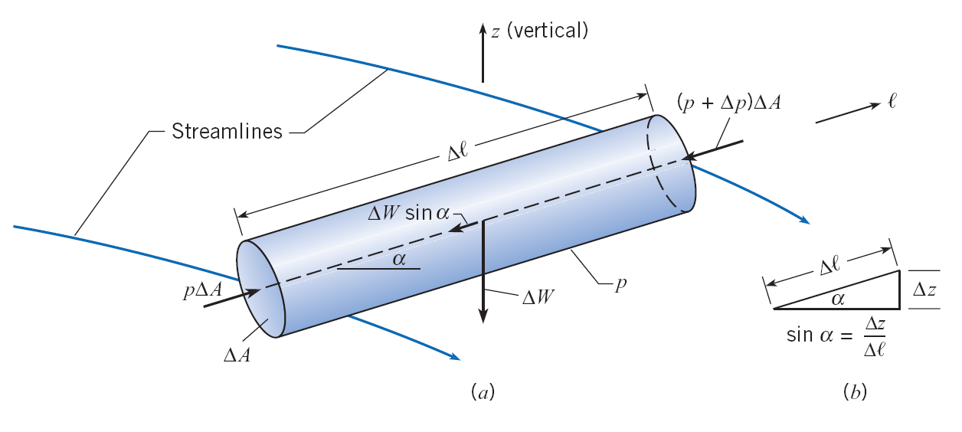
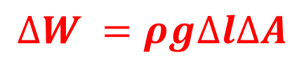
Euler’s Equation
Consider a small cylindrical element oriented in arbitrary direction l
Force analysis only along l direction
Assume no viscous forces (inviscid)
Pressure force 2
Pressure force 1
Gravity
$$∆W =ρg∆l∆A$$
Cross section
Notes:
viscous force is like the friction force exerted on the cylindrical element due to the fluid motion.

Slide 5
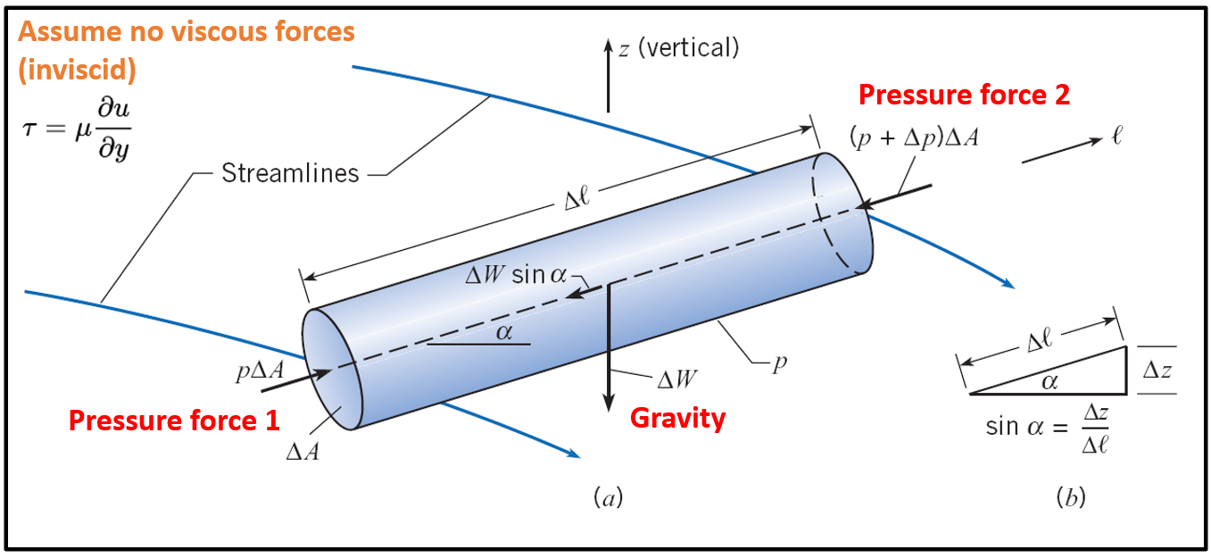
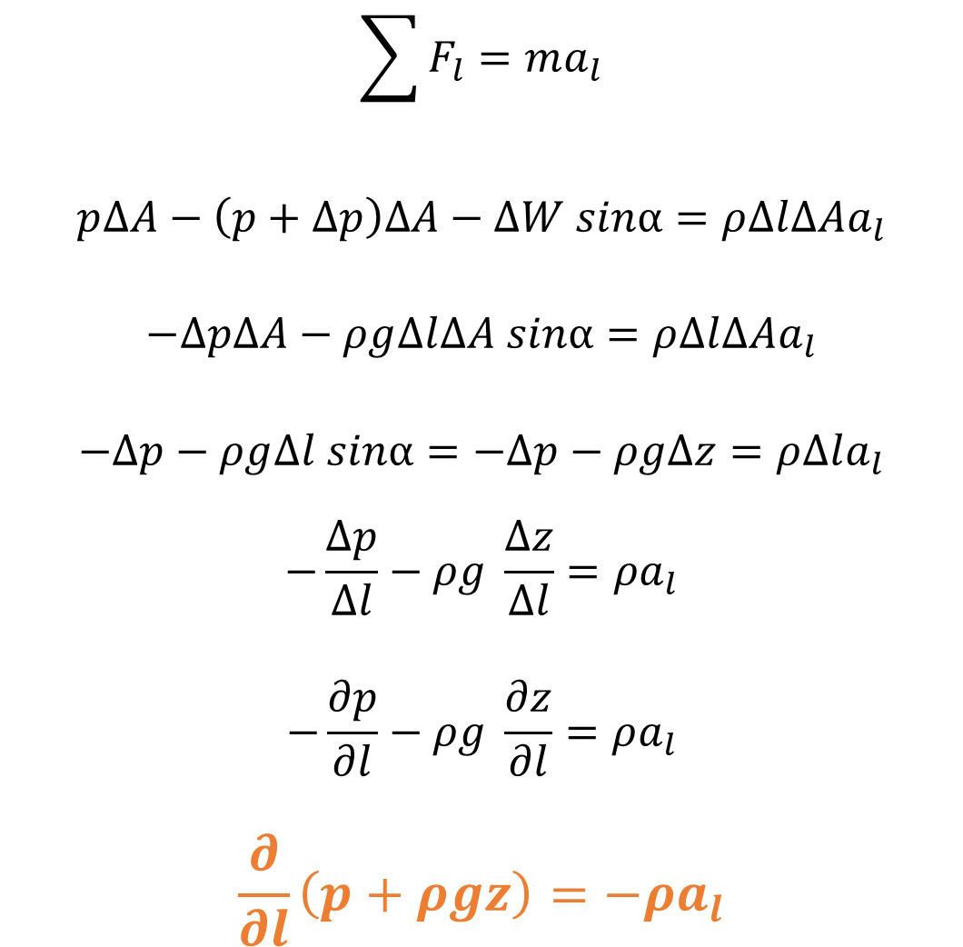
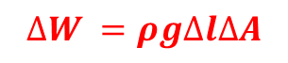
Euler’s Equation
Force analysis only along l direction: apply Newton’s 2nd law
$$\sum{F_{l}}=ma_{l}$$
$$p∆A−\left(p+∆p\right)∆A−∆W sinα=ρ∆l∆Aa_{l}$$
$$−∆p∆A−ρg∆l∆A sinα=ρ∆l∆Aa_{l}$$
$$−∆p−ρg∆l sinα=−∆p−ρg∆z=ρ∆la_{l}$$
$$−\frac{∆p}{∆l}−ρg \frac{∆z}{∆l}=ρa_{l}$$
$$−\frac{∂p}{∂l}−ρg \frac{∂z}{∂l}=ρa_{l}$$
$$\frac{∂}{∂l}\left(p+ρgz\right)=−ρa_{l}$$
$$∆W =ρg∆l∆A$$
Valid only for inviscid, incompressible (ρ constant) flow

Slide 6
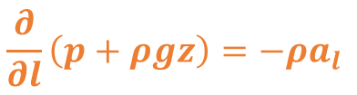
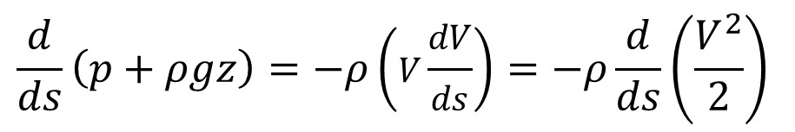
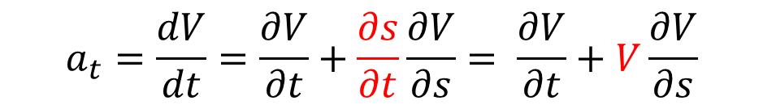
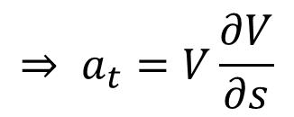
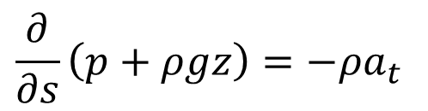
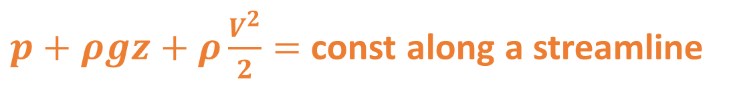
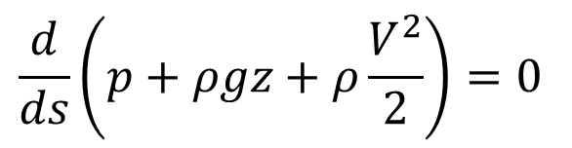
Bernoulli’s Equation
Velocity
Start from Euler’s
arbitrary direction l
Choose l to be the tangential direction of the streamline e_{t}
Acceleration
$$\frac{∂}{∂s}\left(p+ρgz\right)=−ρa_{t}$$
Velocity flow field along one streamline
$$a_{t}=\frac{dV}{dt}=\frac{∂V}{∂t}+\frac{∂s}{∂t}\frac{∂V}{∂s}= \frac{∂V}{∂t}+V\frac{∂V}{∂s}$$
Acceleration field
$$⇒ a_{t}=V\frac{∂V}{∂s}$$
Assume steady
$$\frac{d}{ds}\left(p+ρgz\right)=−ρ\left(V\frac{dV}{ds}\right)=−ρ\frac{d}{ds}\left(\frac{V^{2}}{2}\right)$$
Inviscid, incompressible, steady flow
$$\frac{d}{ds}\left(p+ρgz+ρ\frac{V^{2}}{2}\right)=0$$
$p+ρgz+ρ\frac{V^{2}}{2}=$ const along a streamline

Slide 7
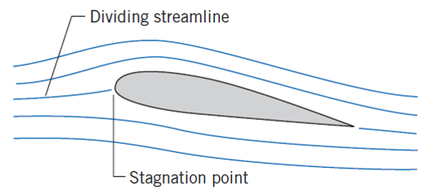
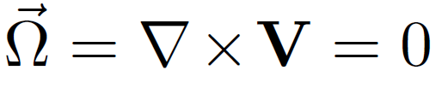
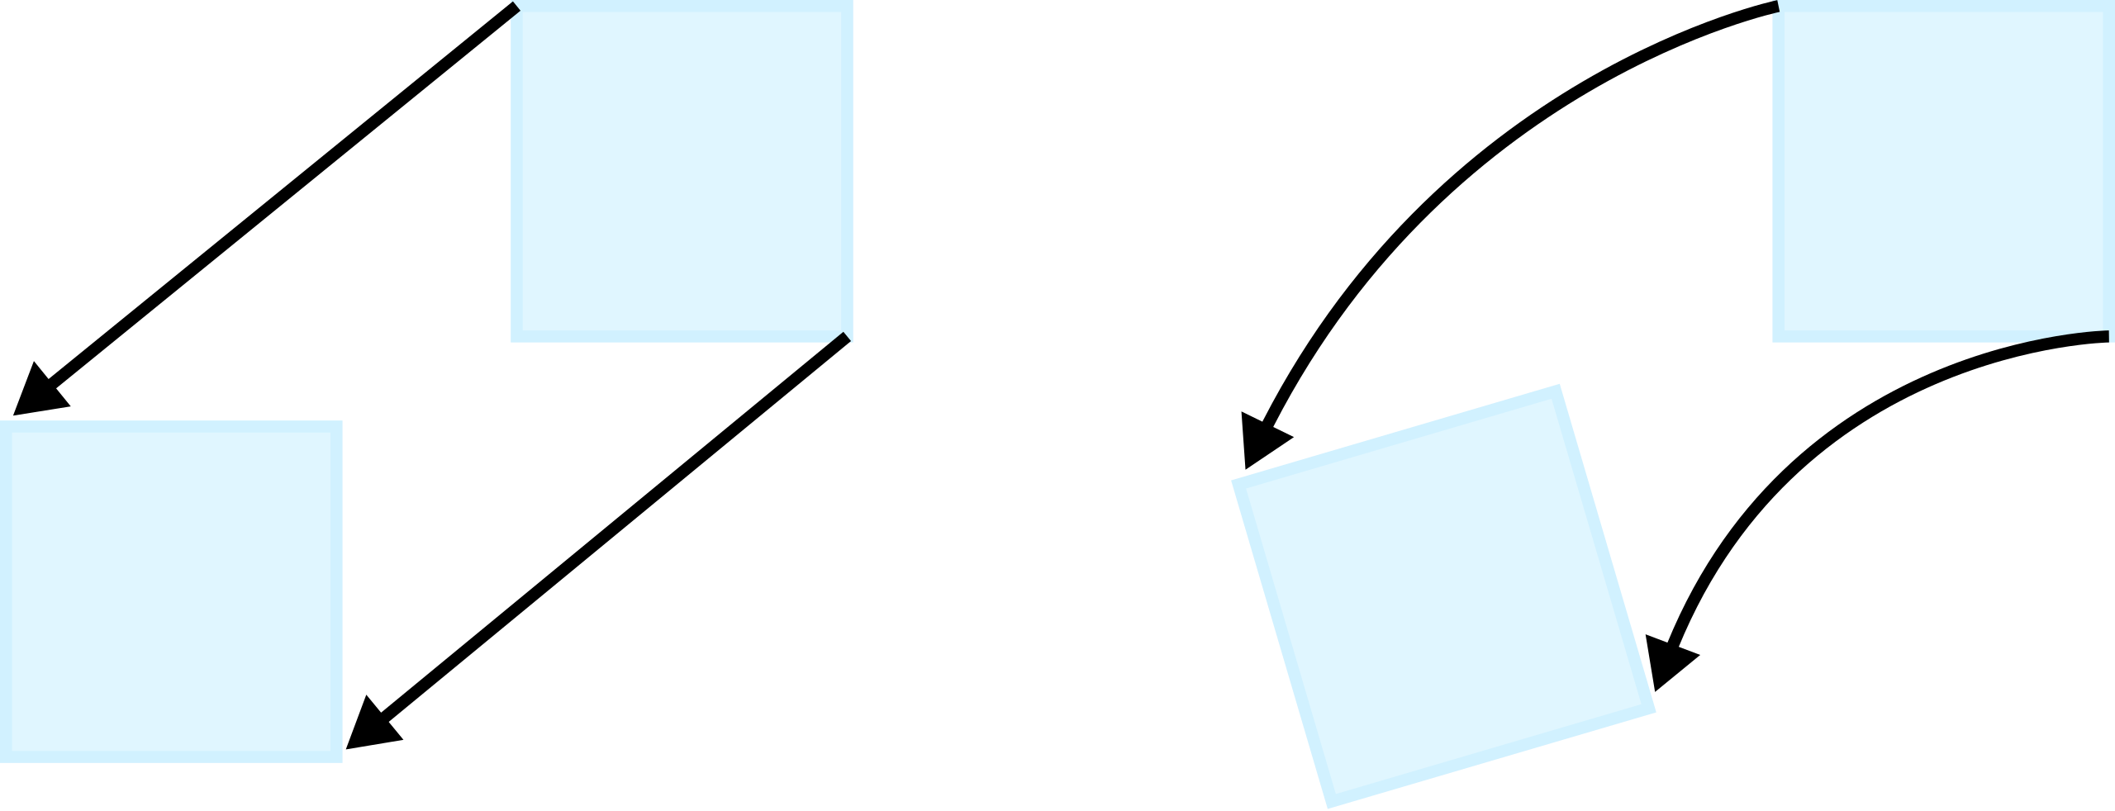
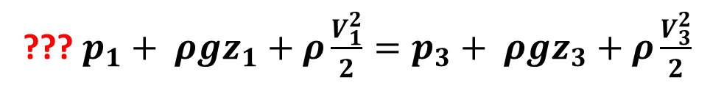
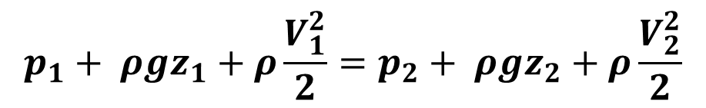
Bernoulli’s Equation
Inviscid, incompressible, steady flow
Along one streamline
1
2
$$p_{1}+ ρgz_{1}+ρ\frac{V_{1}^{2}}{2}=p_{2}+ ρgz_{2}+ρ\frac{V_{2}^{2}}{2}$$
3
??? $p_{1}+ ρgz_{1}+ρ\frac{V_{1}^{2}}{2}=p_{3}+ ρgz_{3}+ρ\frac{V_{3}^{2}}{2}$
What about point 3, or across streamlines?
Bernoulli’s Equation can be applied across streamlines only for irrotational flows (Smits, Ch6)
How does tiny fluid element move with the flow?
Vorticity
irrotational
rotational

Slide 8
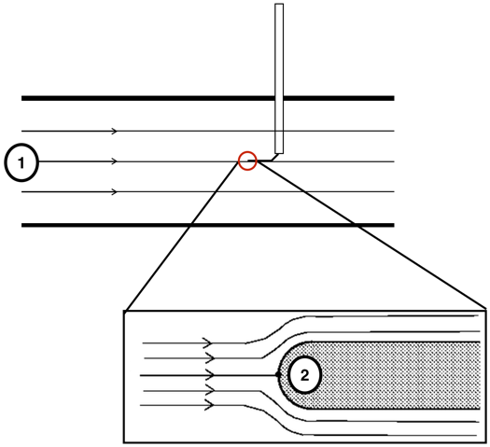
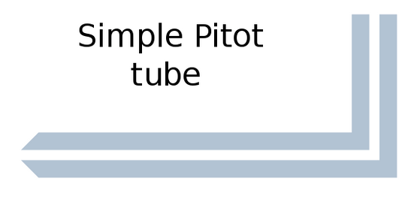
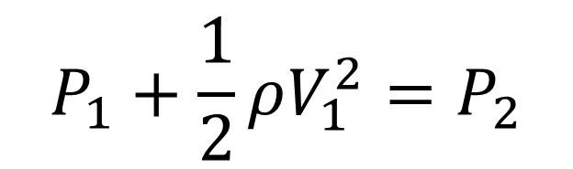
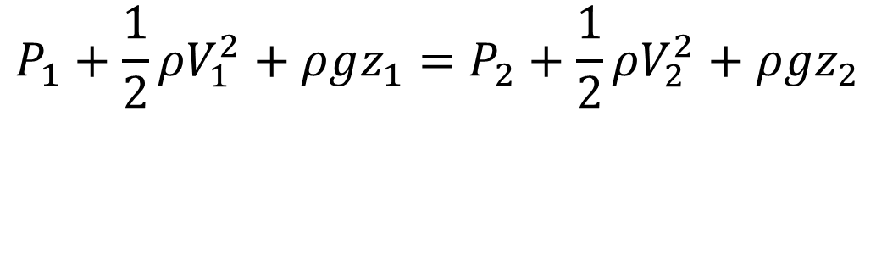
Pitot Tube and Bernoulli’s Equation
$$P_{1}+\frac{1}{2}ρV_{1}^{2}+ρgz_{1}=P_{2}+\frac{1}{2}ρV_{2}^{2}+ρgz_{2}$$
Velocity @ stagnation point V₂= 0
z₁ = z₂
Dynamic Pressure
$$P_{1}+\frac{1}{2}ρV_{1}^{2}=P_{2}$$
Stagnation point
V = 0
Total Pressure
(Stagnation Pres.)
Static Pressure
How to measure the pressure?
Manometer!
The one in our lab kits

Slide 9
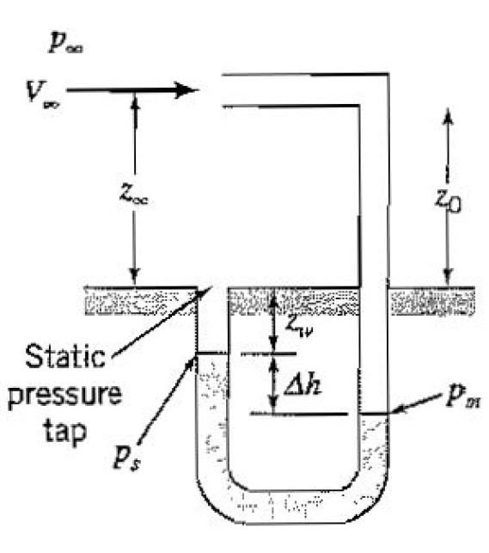
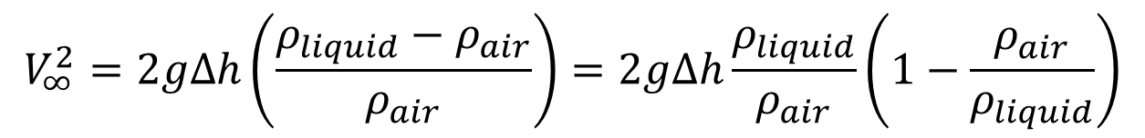
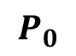
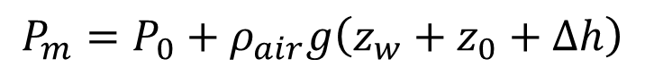
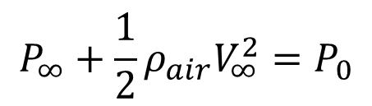

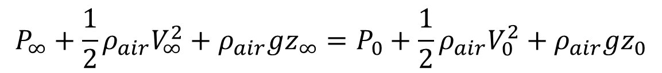
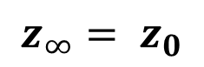
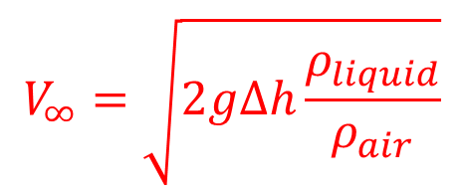
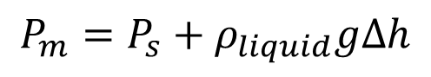
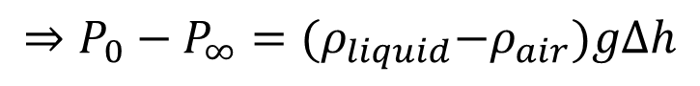
U-tube Manometer: pressure measurement
Bernoulli’s equation (along the same streamline)
Stagnation point
$$P_{∞}+\frac{1}{2}ρ_{air}V_{∞}^{2}+ρ_{air}gz_{∞}=P_{0}+\frac{1}{2}ρ_{air}V_{0}^{2}+ρ_{air}gz_{0}$$
$$P_{0}$$
$$P_{∞}+\frac{1}{2}ρ_{air}V_{∞}^{2}=P_{0}$$
$$z_{∞}= z_{0}$$
Hydrostatic equations
$$P_{s}=P_{∞}+ρ_{air}g\left(z_{w}+z_{0}\right)$$
$$P_{m}=P_{0}+ρ_{air}g\left(z_{w}+z_{0}+Δh\right)$$
$$P_{m}=P_{s}+ρ_{liquid}gΔh$$
$$⇒P_{0}−P_{∞}={(ρ}_{liquid}−ρ_{air})gΔh$$
Combined together
$$ρ_{liquid}≫ρ_{air}$$
$$V_{∞}^{2}=2gΔh\left(\frac{ρ_{liquid}−ρ_{air}}{ρ_{air}}\right)=2gΔh\frac{ρ_{liquid}}{ρ_{air}}\left(1−\frac{ρ_{air}}{ρ_{liquid}}\right)$$
Liquid
Detailed Example (P85)
$$V_{∞}=\sqrt{2gΔh\frac{ρ_{liquid}}{ρ_{air}}}$$
A. Smits, A Physical Introduction to Fluid Mechanics
Notes:
Cannot neglect that term if you are measuring the liquid velocity instead of air velocity, (putting pitot tube in another liquid)

Slide 10
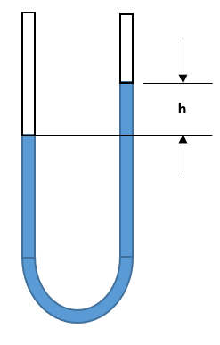

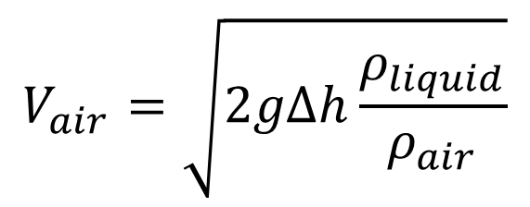
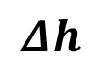
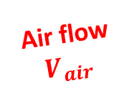
Manometer: pressure measurement
Open end
P₀ = 1 atm
Connect to pitot tube
Stagnation point
$$Δh$$
Air flow
$$V_{air}$$
$$V_{air}=\sqrt{2gΔh\frac{ρ_{liquid}}{ρ_{air}}}$$
Pitot Tube Built by Mike Vocaturo
The stagnation point is at the tip of the small metal tube inside.

Slide 11
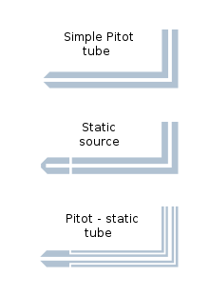
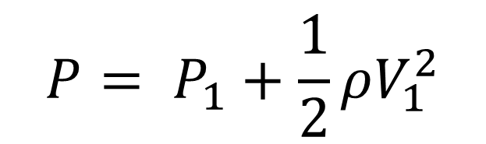
Pitot Tube, Piezometer and Pitot Static Tube
Different tip designs
$${P= P}_{1}+\frac{1}{2}ρV_{1}^{2}$$
Total Pressure / Stagnation Pressure
The one in our lab kits
Static Pressure
Stagnation point
Combination: can measure total pressure and static pressure
=> Can directly determine the local flow velocity (P_{total} – P_{static})

Slide 12
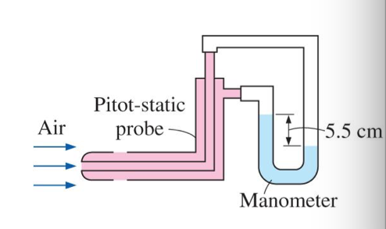
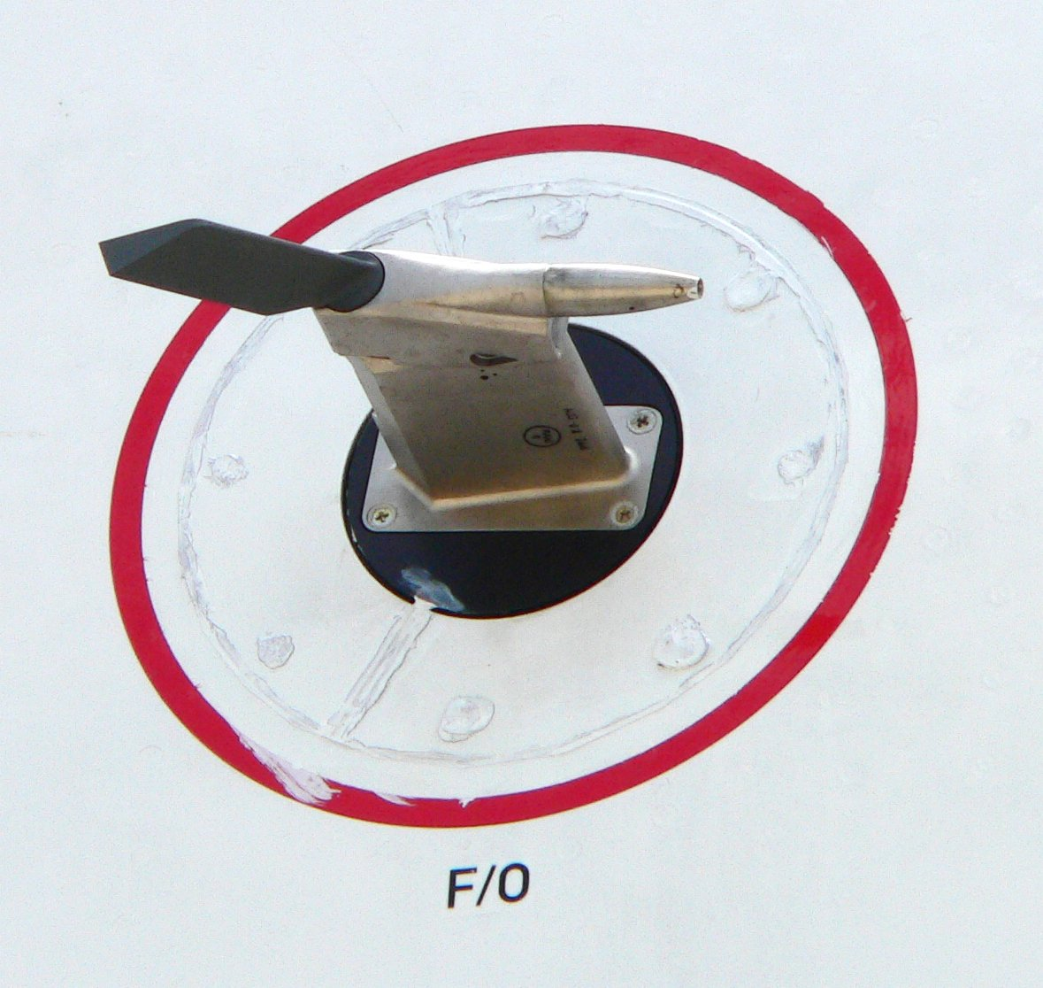

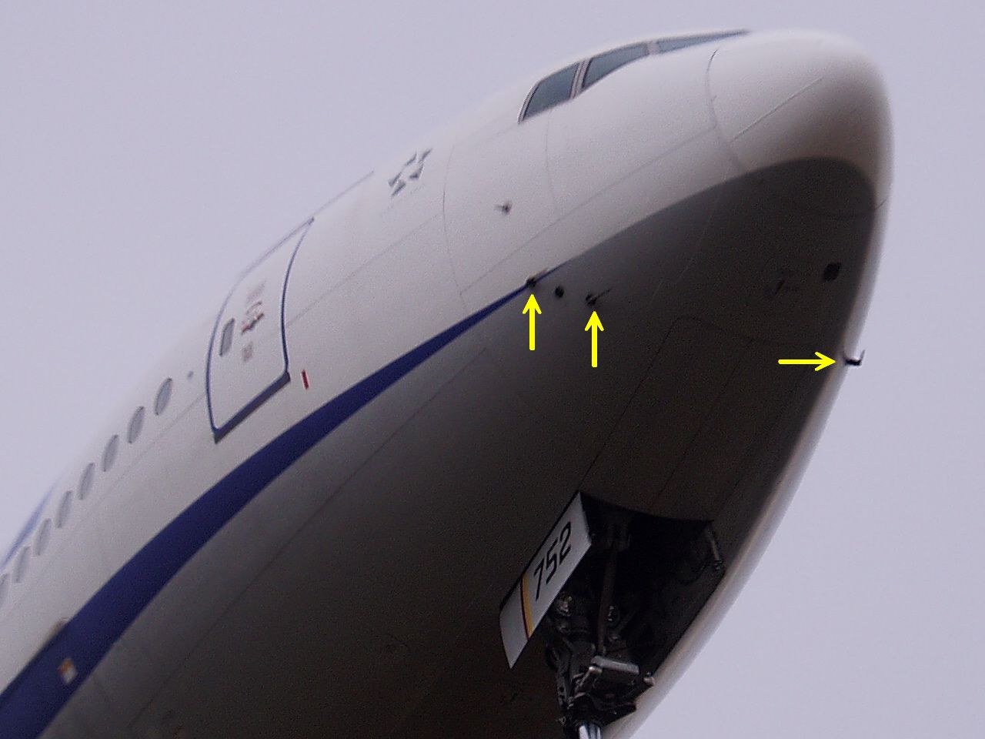
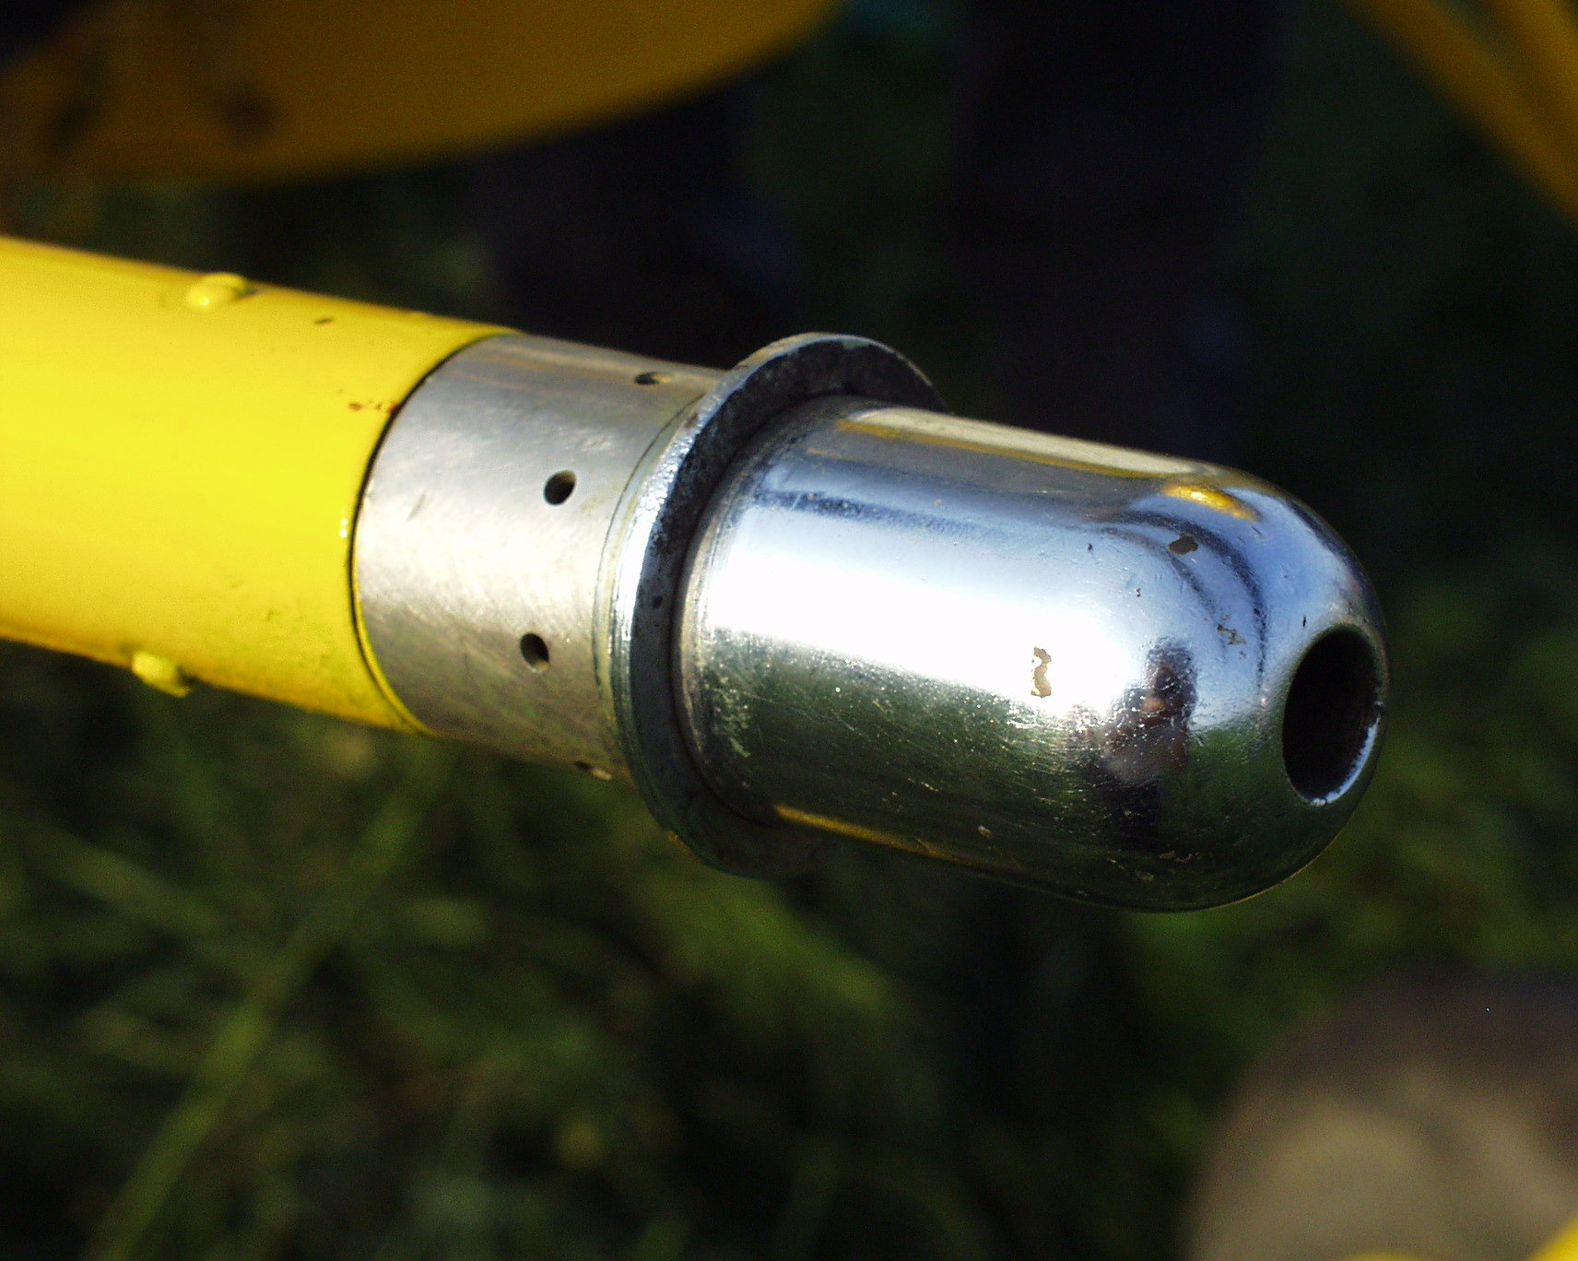


Pitot Static Tube
Airbus A380
Stagnation point
Airflow
$$V_{air}=\sqrt{2gΔh\frac{ρ_{liquid}}{ρ_{air}}}$$
$$Δh$$
Total pressure
Static pressure
Pitot tubes on
Boeing 777
Kamov Ka-26 helicopter
https://en.wikipedia.org/wiki/Pitot_tube
Aircraft use pitot tubes to measure airspeed.

Slide 13


Pitot Static Tube
Formula one
https://en.wikipedia.org/wiki/Pitot_tube

Slide 14
Other velocity measurements
Vane and cup anemometer
Hot-wire anemometer
Particle Image Velocimetry
Phase Doppler Anemometry

Slide 15


Other velocity measurements
Vane and cup anemometer: the speed of rotation is proportional to flow speed
Vane and cup anemometer is used to measure wind speed or water speeds.

Slide 16


Other velocity measurements
Hot-wire anemometer
Flow causes hot wire to cool down as a result of convection;
Resistance of hot wire changes, causing voltage also to change;
Measure voltage change to calculate flow velocity.
Good for measuring velocity fluctuations in turbulent flows
Small sensing element reduces disturbance to surrounding flow

Slide 17

Other velocity measurements
Particle Image Velocimetry (PIV): full-field, non-intrusive
Seed tiny particles (1-10 um) in the flow that completely follow fluid motion
Illuminate particles with a laser sheet parallel to velocity field of interest
Camera records two images of particles at two laser pulses
Calculate the particle displacement between two images.
Velocity = displacement/Δt

Slide 18
Other velocity measurements
Particle Image Velocimetry (PIV): full-field, non-intrusive
Flow Motion

Slide 19

Other velocity measurements
Phase Doppler Anemometry (PDA): non-intrusive, high accuracy
Probe volume is small, but can be compensated by scanning the whole flow field
Also need to seed tiny particles
Light is scattered from particles, which contains a doppler frequency shift proportional to particle velocity
Velocity can be calculated by the frequency of the interference pattern collected by the photo-detector

Slide 20
Any Questions?

Slide 22

Lagrangian and Eulerian Flow Descriptions
Lagrangian: follow individual fluid particle and determine how the fluid properties change with time.
Eulerian: fluid properties at fixed points, as functions of both space and time.
Eulerian: measure temperature at different points (x,y)
Temperature field T = T (x,y,t)
Similarly, velocity field…
Lagrangian: follow particle A, and measure its temperature only, T_{A} = T_{A} (t)
Donald F. Young
A Brief Introduction to Fluid Mechanics
Example of smoke discharging from chimney
Notes:
To understand the principles of pitot tube, we should start from the basic concepts in fluid kinematics.
Eulerian is usually the easier way to describe a flow.

Slide 23







3D Velocity field
All three components depend on space (x, y, z) and time (t)
How to express acceleration for a fluid particle?
Along the particle path, V_{A} is a function of space and time
Position is also a function of time!
By definition of acceleration and chain rule
Donald F. Young
A Brief Introduction to Fluid Mechanics
3D Acceleration field!
Notes:
With the eulerian flow description,

